Slide 1

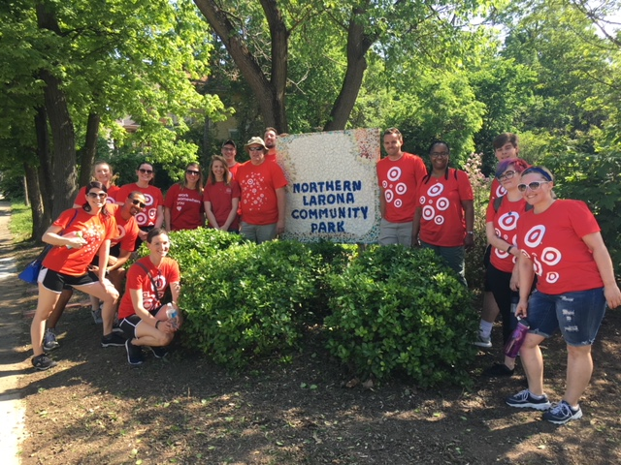
Target 2557

Slide 2
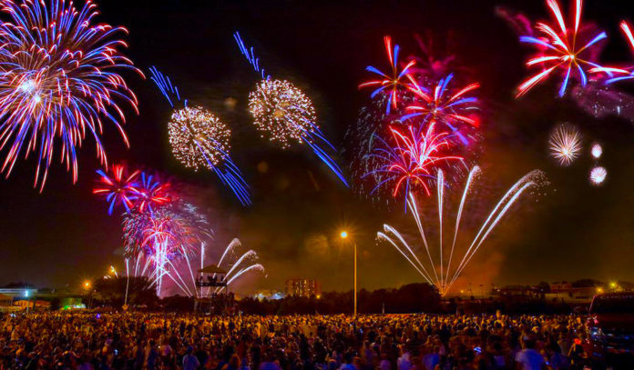
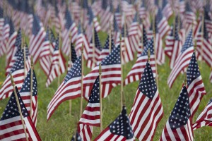
July 1st-July 7th

Slide 3

Target News!
July 1st-July 7th Here's what's happening across Target: 7/2: Those great deals and strong everyday prices on all things Fourth of July continue, both in-store and on dot-com.
KNOW THE PROMOs:
Free $5 giftcard with meat or seafood purchase of $20 or more—get your grill on! 20% off apparel & accessories cartwheel offer ☺

Slide 4

Want to learn more about Sales?
DID YOU KNOW?
You can use the MPM2.0 App (myPerformance Mobile 2.0) on the Zebra to learn more about sales in your work center!
You can use this app to learn more about:
Yesterday’s Sales
Month-to-Date and Year-to-Date sales
What’s selling & what’s not
Where to focus your selling efforts with guests
Partner with Maria, Eric, Tedra or the LOD to learn more about the MPM2.0 app.
Let’s drive some SALES!!!

Slide 5


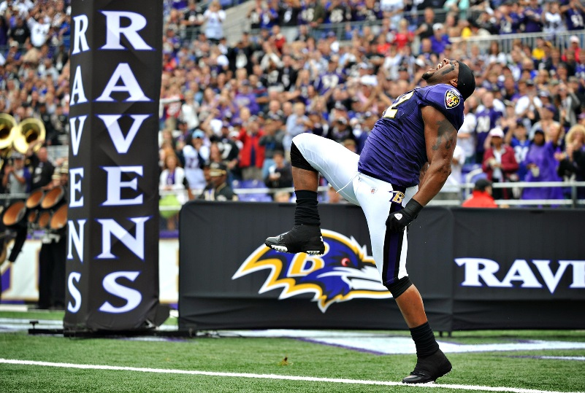
Top Seller!
Sales Dollars
Congrats to Josh M for being BOTH the unit and the $ amount winner!
Please enjoy a Starbucks on us for your efforts!

Slide 6

Beauty, Electronics, and A&A Training
ATTENTION:
Mandatory Weekly Training!
Beauty: 4th of July Video and Warm Weather Essentials Product Knowledge, finish up Hair Care Certification!
5/6 Style: Fixture Blocking 101
5/6 Electronics: finish up Brand Launch Heydey training

Slide 7
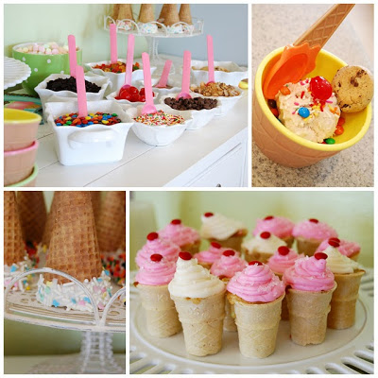
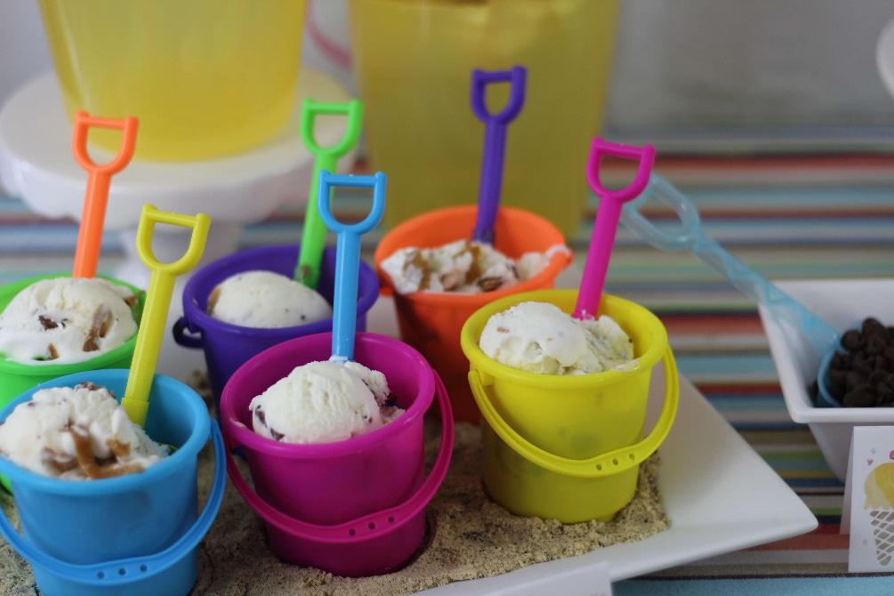
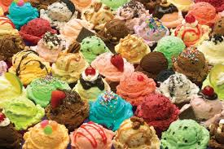
FUN this week!
Ice Cream Bar on Wednesday to celebrate the 4th!☺

Slide 8
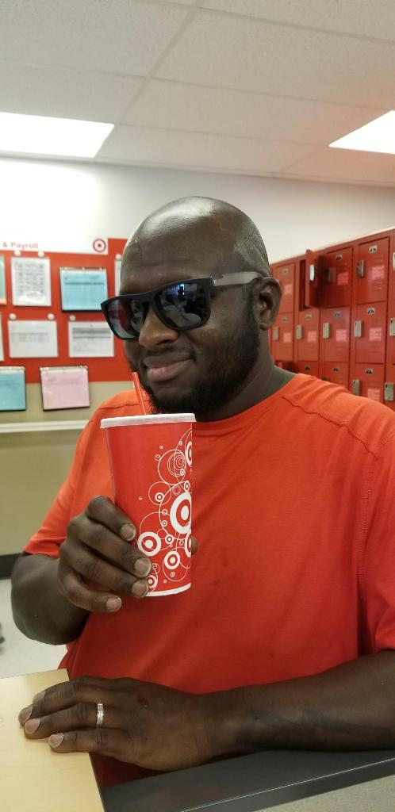
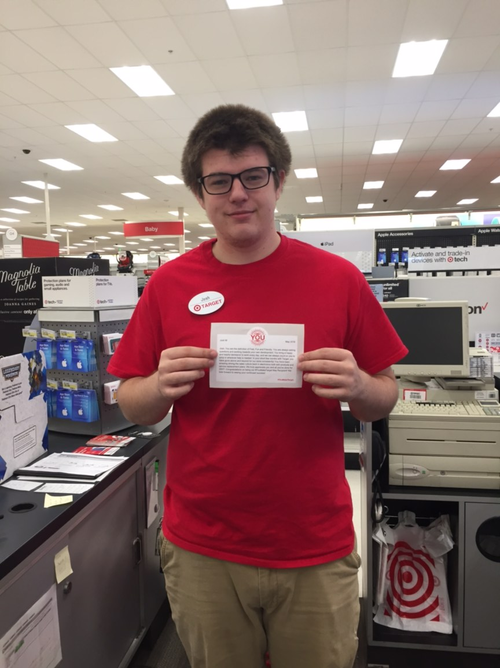

May ‘You Make Target’ Award Winners
Congrats Josh
and Marcus!

Slide 9
Interested in doing more with Target?
Please see Maria in HR or your ETL to sign up for a ‘Development’ Chat Time Slot!

Slide 10
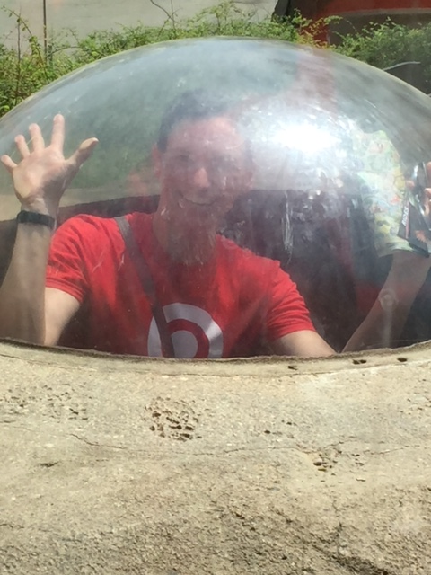


Volunteer Hours Goal
HELP! We are at 213/423 hours for the year!
Any hours you volunteer on your own time can count towards our volunteer goal. Please let Sally or Maria know the dates and hours you’ve volunteered so we can get credit!
Have an opportunity you’re passionate about? Let a leader know!!

Slide 11
Compliance Violations Last Week
0
Nice job!

